Slide 1


Virtual Warehouse / Spot Transfer
Quick Reference Guide
Beat Thalmann / August 2015

Slide 2
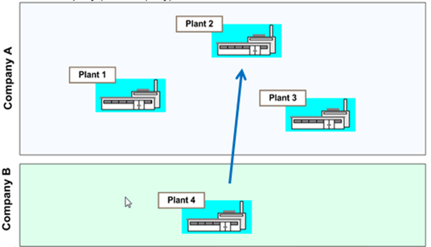
Introduction
Virtual warehouse storage location is available in all plants. All users with the respective authorization rights have the visibility of all materials stored in V200 in- or outside the OpCO.
Using the classification system defined in the standard naming convention it is possible to search for materials within all plants which are in EBM.
Spot transfer:
Material is available in another plant and can be transferred when needed. In this case, we are talking about a manually managed spot transfer. This transfer can be to a plant in the same OpCo or to a different OpCo.

Slide 3
Process steps
•Demand of a part
•Master data check and alignment
•PR / PO / Outbound delivery creation
•Goods issue / Goods receipt
•Invoice creation and payment

Slide 4

Demand of a part
Maintenance detects during planning the need of a spare part
The material can be searched via ZMM003 with «*» in field plant
This part can be either stored in the own warehouse, or in the warehouse of another plant within EMEA. If not, it has to be ordered by the supplier
If the part has to be purchased external the normal P2P Flow applies
If the part is available within EMEA the spot transfer flow applies
Before starting the spot transfer process contact the plant, where the material was found and inform them about the need.
After validation and agreement about terms and conditions start the spot transfer process.

Slide 5
Material Id check
Material Id requirements
Same material Id existing in both plants. Go to step «master data alignment»
Different material Id’s existing in plants. The receiving plant (demanding plant) requests via MASIMO the extension of the material Id used in the sending plant. After material extension go to «step master data alignment»


Slide 6
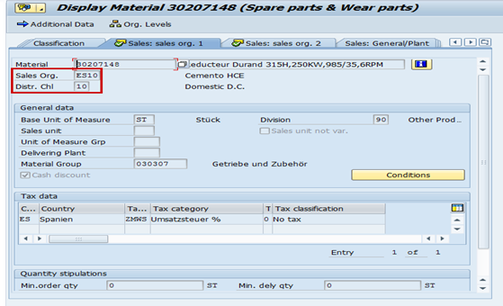
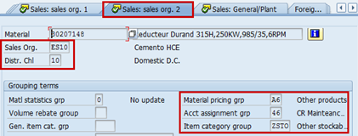
Master data check and alignment (Sales view)
Check Sales view in material master data of the sending plant. Sending plant has to request to create the sales views.
View: «Sales: Sales org. 1»
Sales Organization country and business cement
Distribution channel: 10 (standard EBM)
View «Sales: Sales org. 2»
Material pricing group
Account assignment group
Item category group

Slide 7
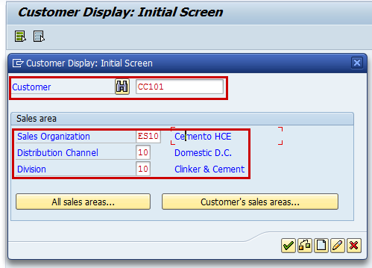
Master data check and alignment (Customer)
The sales organization of the sending plant has to create the receiving plant as a customer in their sales area.
Customer: use the plant-vendor Id of the receiving plant

Slide 8
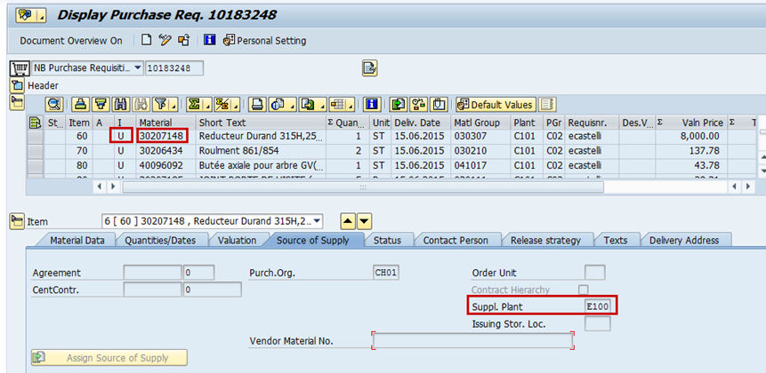
Create PR (Purchase Requisition) for Stock Transfer
The receiving plant creates a PR for the stock transfer of the material from the sending plant.
Item category: «U – Stock transfer»
Material id
Supplying plant: plant code of sending plant
Price: according to agreed terms and conditions
Transport can be organized by sending plant and invoiced to receiving plant or organized by receiving plant.
See: P2P Material Transfer Process Overview.xlsx

Slide 9
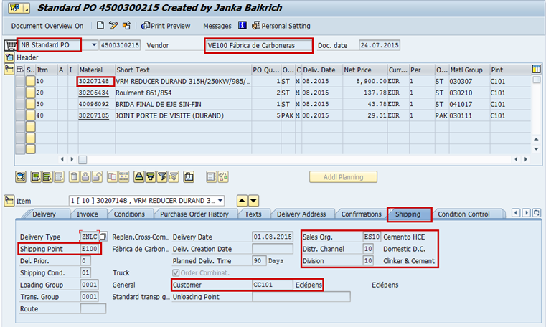
Create PO (Purchase Order) for Stock Transfer
After the release of the PR, the PO can be created by the procurement department of the receiving plant.
Creation of PO with type: «NB»
Check: Vendor, Sales organization, shipping point and customer


Slide 10
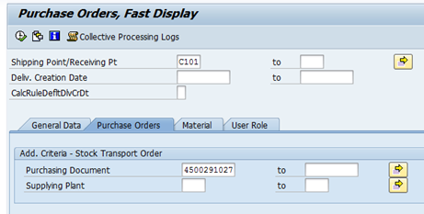
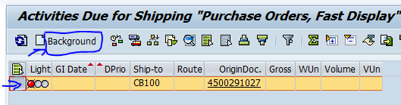
Create Outbound delivery document
Sending plant creates based on the PO the outbound delivery document, using Transaction: VL10B
Select the line and than click on Backround tab

Slide 11
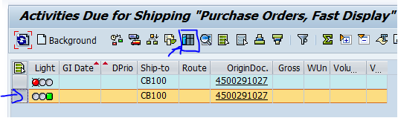
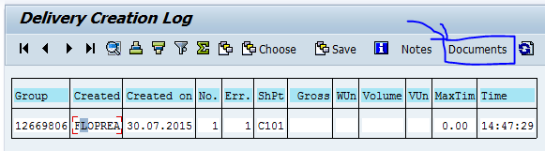
Create Outbound delivery document
Select the second line and click on the log tab
Click on Documents tab

Slide 12
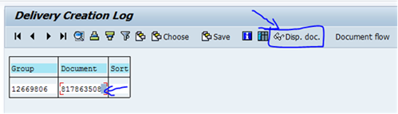
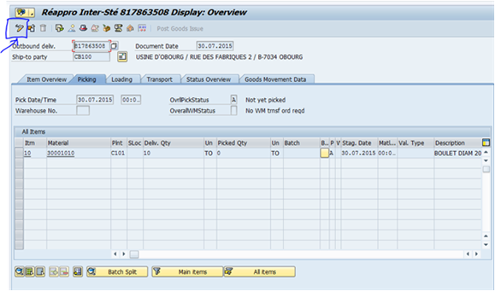
Create Outbound delivery document
Select the document number then click on Display document
Click to go from display to change

Slide 13
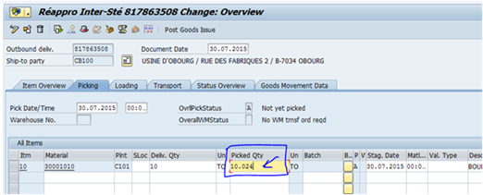
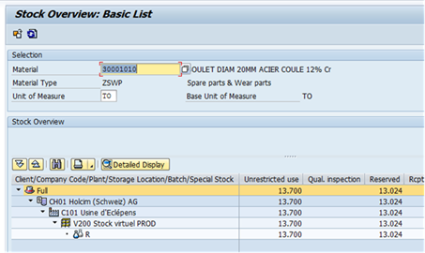
Create Outbound delivery document
Introduce the picked quantity (the net weight as in bill of ladding)
MMBE before saving the good issue (another SAP window)

Slide 14
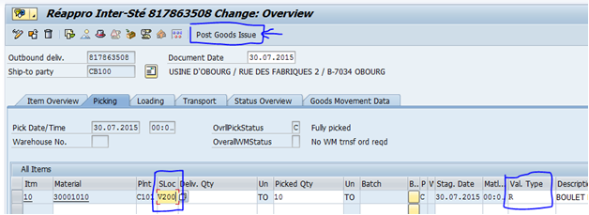

Create Outbound delivery document
Then post the good issue

Slide 15
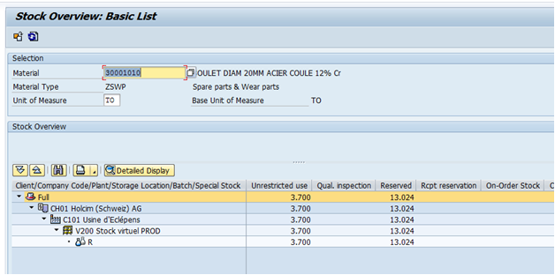
Create Outbound delivery document
Check MMBE after saving

Slide 16
Goods issue to the outbound delivery document
Sending plant posts Good issue with MIGO against the outbound delivery document / PO
Create Bill-of-ladding / Proforma Invoice for customs clearance
Organization of transport

Slide 17
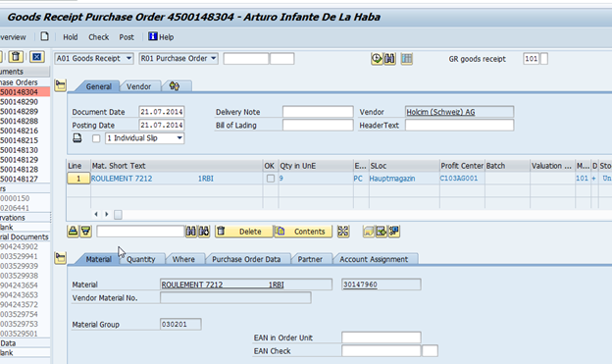
Goods receipt against PO
Receiving Plant posts GR with MIGO against PO
Check with MMBE / MB52 the stock level

Slide 18
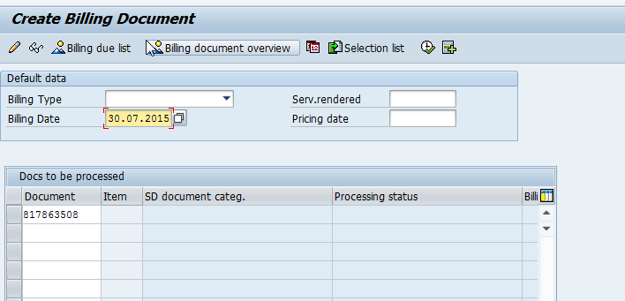
Invoice creation and payment
The sending plant (A/R) creates the invoice for the delivery using transaction: VF01
Send the invoice to the receiving plant
Upon receipt of the material and invoice receiving plant (A/P) pays the invoice

Slide 19

Consumption of part
The parts can be consumed via work order with the normal PM Flow

Slide 20


